Slide 1
Convolutional Neural Networks
S.Mohana Saranya
Assistant Professor
Computer Science & Engineering
Kongu Engineering College

Slide 2
Neurons in Human Vision
The human sense of vision is unbelievably advanced.
Somehow our eyes take in raw voxels of color data, but our brain transforms that information into more meaningful primitives—lines, curves, and shapes—that might indicate, for example, that we’re looking at a house or cat.
Foundational to the human sense of vision is the neuron. Specialized neurons are responsible for capturing light information in the human eye.
This light information is then preprocessed, transported to the visual cortex of the brain, and then finally analyzed to completion.

Slide 3
Shortcomings of Feature Selection
Detecting face from a randomly chosen image- to train a traditional machine learning algorithm by giving it the raw pixel values of the image and hoping it can find an appropriate classifier
this doesn’t work very well at all because the signal-to-noise ratio is much too low

Slide 4
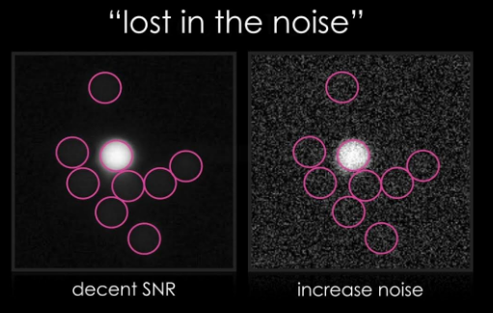
Signal-to-Noise Ratio
High SNR - signal is clear and easy to detect or interpret,
Low SNR - signal is corrupted or obscured by noise and may be difficult to distinguish or recover.
SNR in cameras indicates the signal quality found in an image.
High SNR is required in many embedded vision applications, especially the ones which involve edge-based processing where AI/ML algorithms have to analyze the processed image to take intelligent decisions.

Slide 5
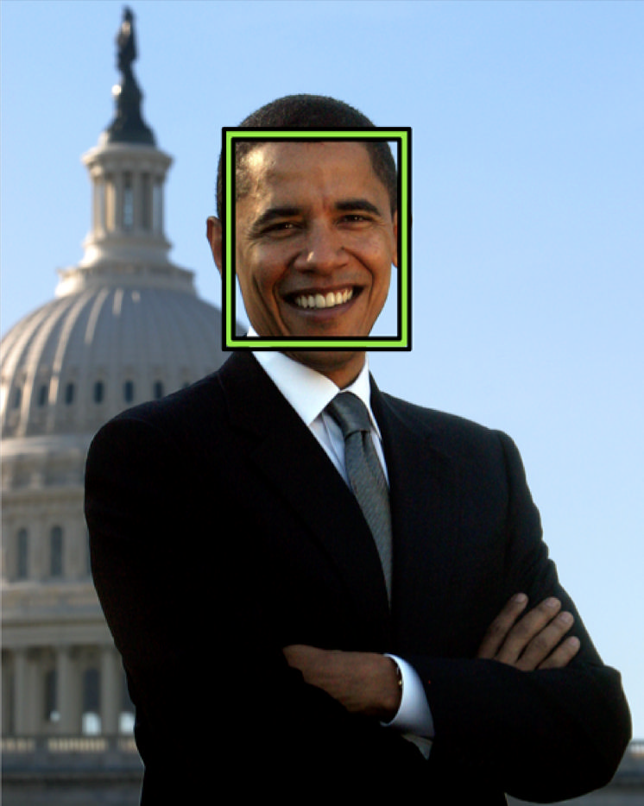
Hypothetical face-recognition algorithm should detect a face in this photograph of former President Barack Obama

Slide 6
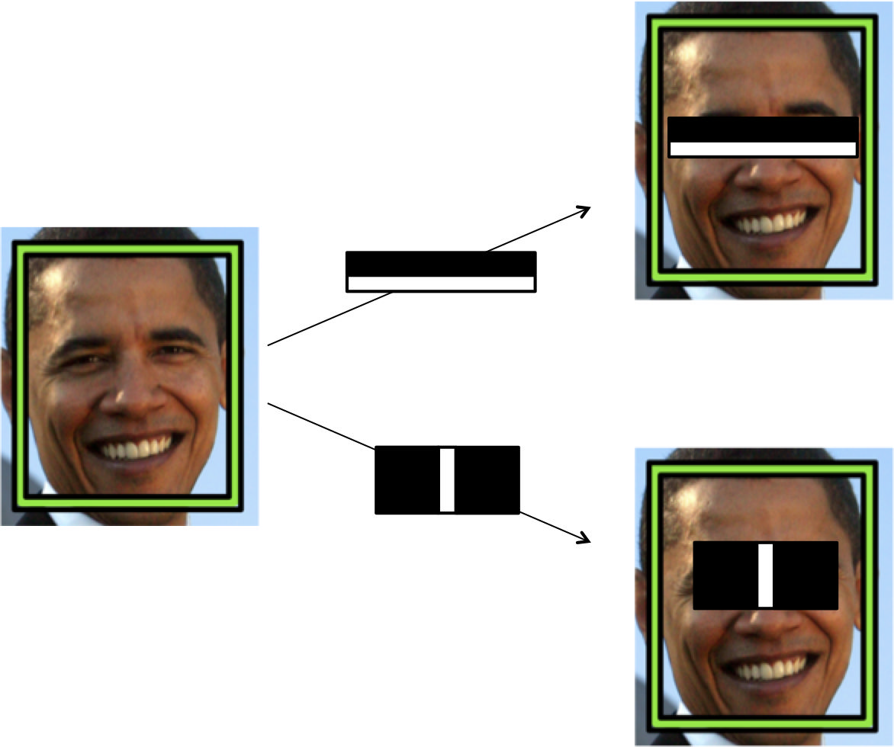
An illustration of Viola-Jones intensity detectors

Slide 7
Faces had certain patterns of light and dark patches that could be exploited for detection
For example, there is a difference in light intensity between the eye region and the upper cheeks, the nose bridge and the two eyes on either side
Each of these features is not very effective at identifying a face.
But when used together (through a classic machine learning algorithm known as boosting) , their combined effectiveness drastically increases. (https://www.merl.com/publications/docs/TR2004-043.pdf)
On a dataset of 130 images and 507 faces, the algorithm achieves a 91.4% detection rate with 50 false positives
the light intensity comparisons no longer work -If a face is partially covered with shade or if the algorithm is looking at a face on the face of a cartoon character

Slide 8
ImageNet challenge in Computer Vision
https://image-net.org/challenges/LSVRC/
Every year, researchers attempt to classify images into one of 200 possible classes given a training dataset of approximately 450,000 images.
The algorithm is given five guesses to get the right answer before it moves onto the next image in the test dataset.
2011 Winner- error rate of 25.7%
2012 Winner- Alex Krizhevsky from Geoffrey Hinton’s lab at the University of Toronto used convolutional neural network - AlexNet ( error rate of approximately 16%)

Slide 9
Vanilla Deep Neural Networks Don’t Scale
For example, for a full-color 200 x 200 pixel image, our input layer would have 200 x 200 x 3 = 120,000 weights. And we’re going to want to have lots of these neurons over multiple layers, so these parameters add up quite quickly!
Clearly, this full connectivity is not only wasteful, but also means that we’re much more likely to overfit to the training dataset.
Convolutional network - analyzing images, and sensibly constrains the architecture of the deep network so that reduce the number of parameters in our model

Slide 10
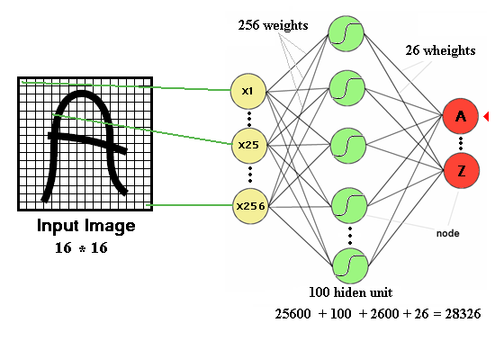
Even a simple 16x16 image
Input to hidden layer: (16x16)x100 + 100
Hidden to Outer layer 100x26 + 26
the number of trainable parameters becomes extremely large

Slide 11
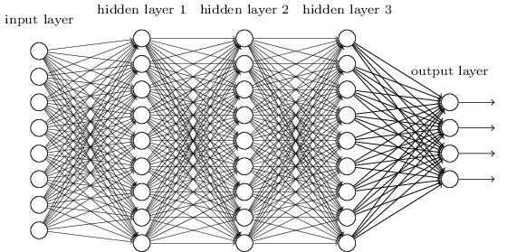
Too many parameters
We know it is good to learn a small model.
From this fully connected model, do really need all the edges?
Can some of these be shared?

Slide 12
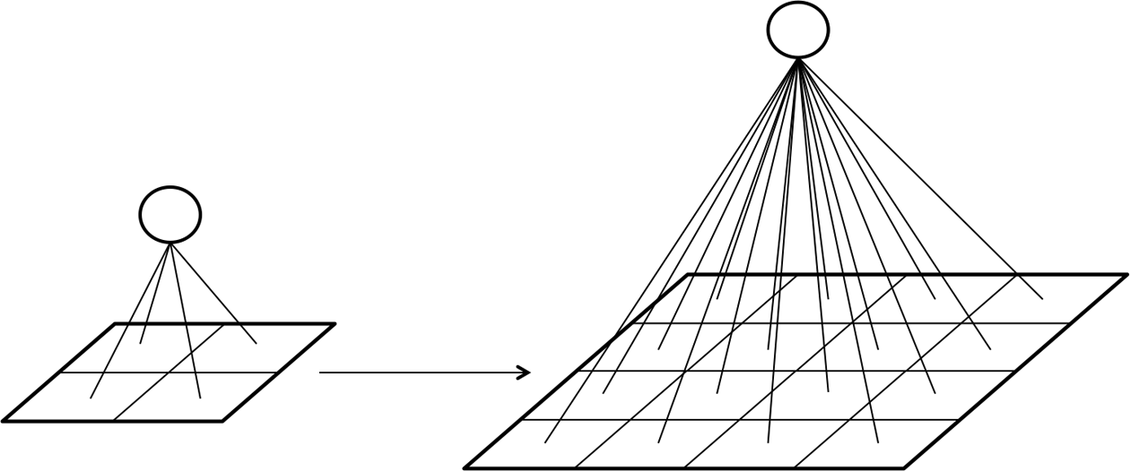
The density of connections between layers increases intractably as the size of the image increases

Slide 13
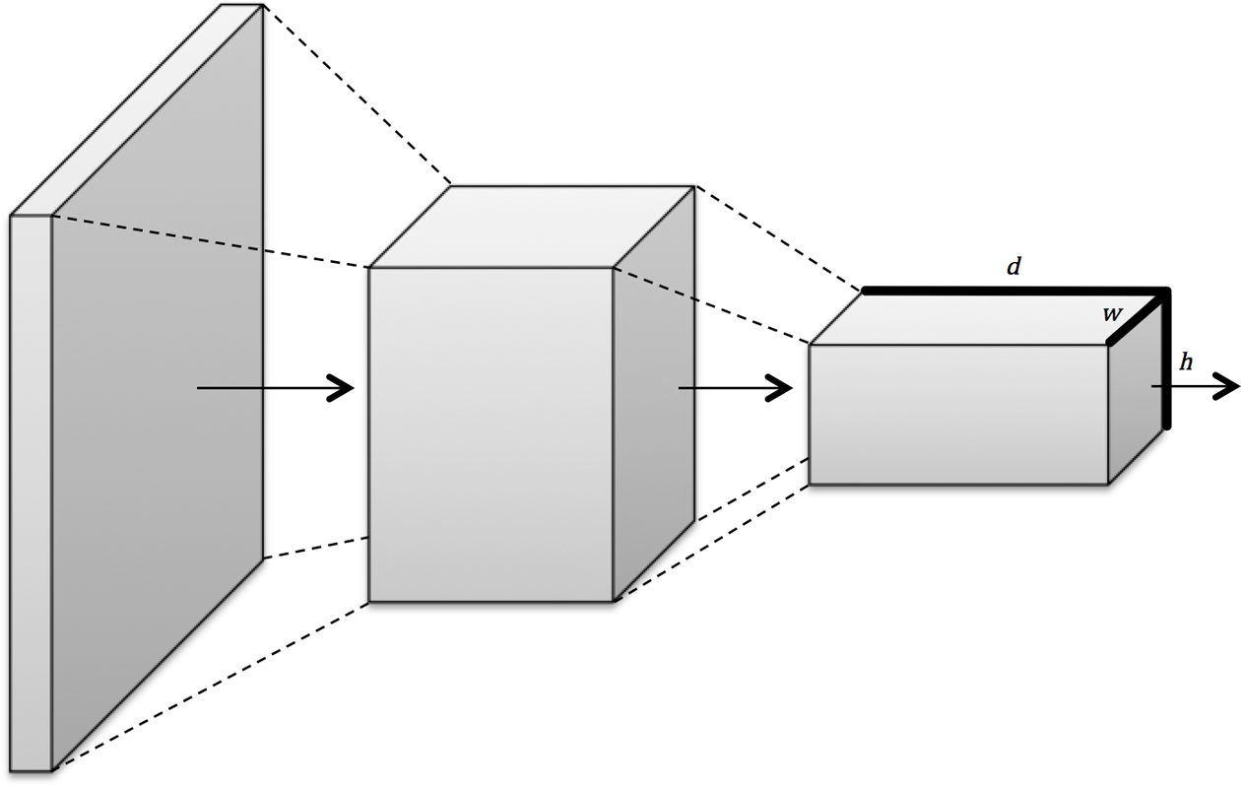
Convolutional layers arrange neurons in three dimensions, so layers have width, height, and depth

Slide 14
What are CNN’s?
NN that use convolution in place of general matrix multiplication in at least one of their layers
Convolutional layer acts as a feature extractor that extracts features of the inputs such as edges, corners , endpoints
An image of 6 x 6 x 3 array of matrix of RGB (3 refers to RGB values) and an image of 4 x 4 x 1 array of matrix of grayscale image.

Slide 15
Use’s of CNN
Image Classification
Object Detection
Image Segmentation
Video analysis
Signal Processing
Natural Language Processing (NLP)
Speech recognition

Slide 16

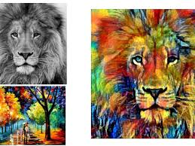
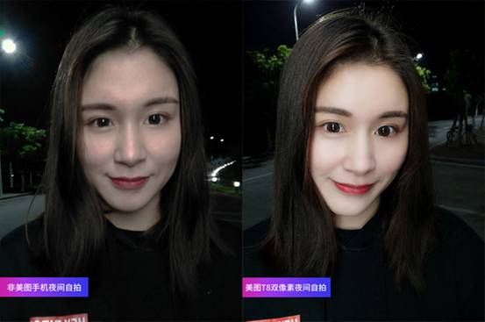
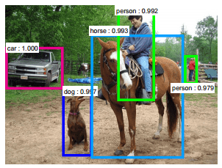
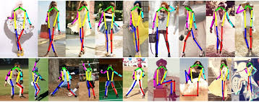
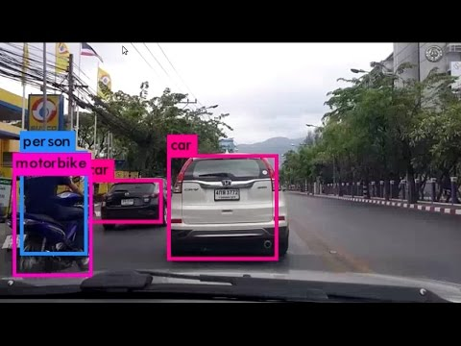
APPLICATIONS OF CNN
Image quality enhancement
Beautification
Face Recognition
Style Transferring
Object detection (Self driving car)
Classification
Gesture Recognition

Slide 17
CNNs Vs. ANNs
ANNs suffer from curse of dimensionality when it comes to high resolution images
We use filters (receptive fields) to exploit spatial locality by enforcing a local connectivity pattern between neurons of adjacent layers
Parameter Sharing
Sparsity of connection

Slide 18
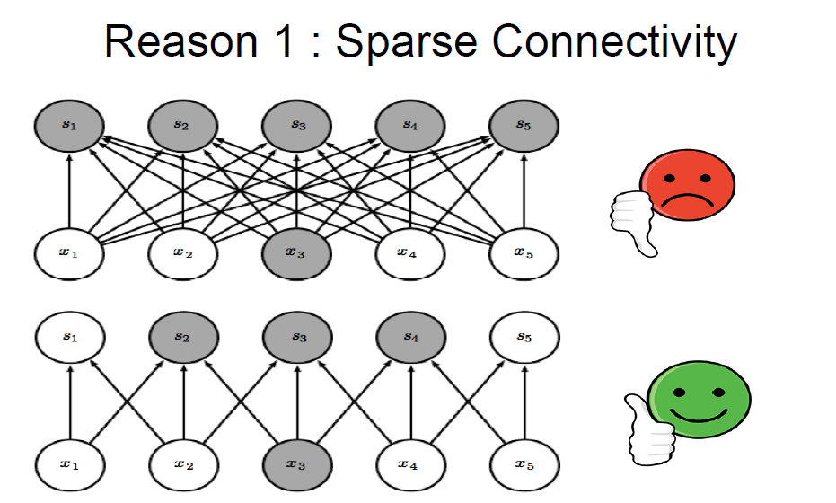

Slide 19
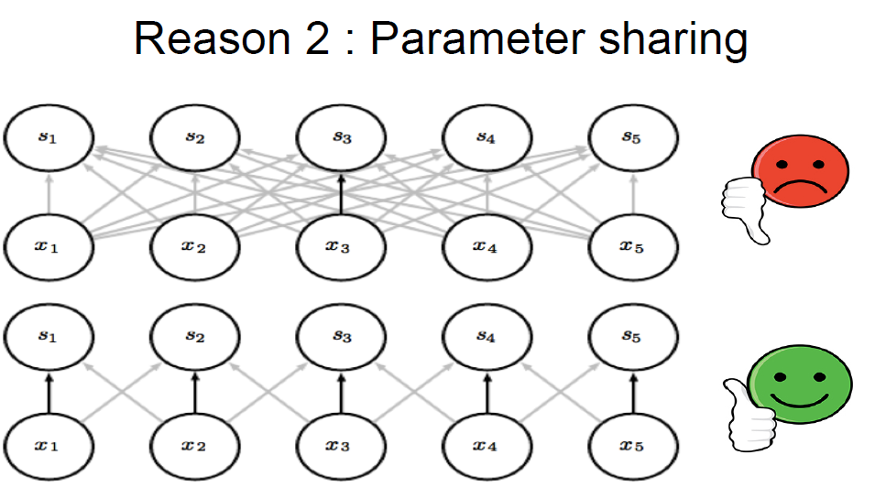

Slide 20
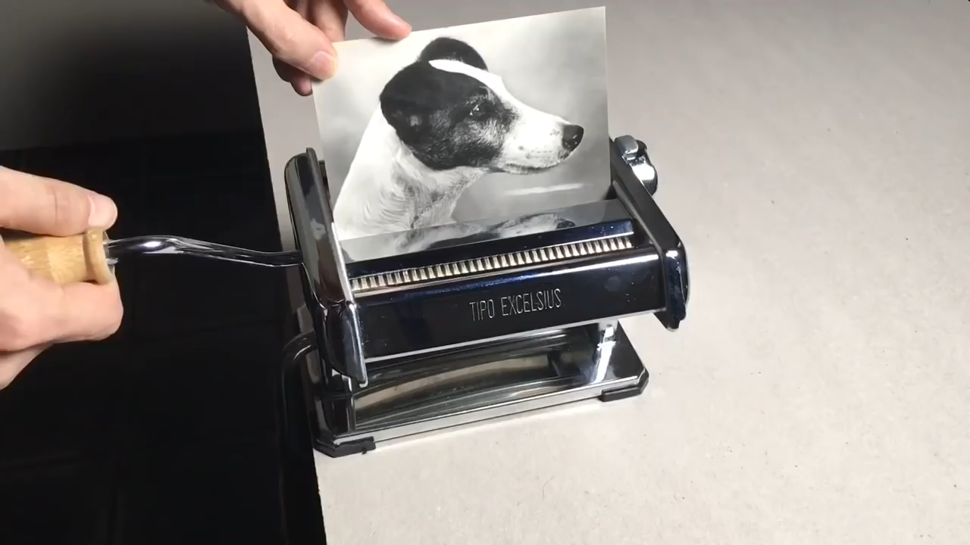
https://www.youtube.com/watch?v=f1fXCRtSUWU

Slide 21
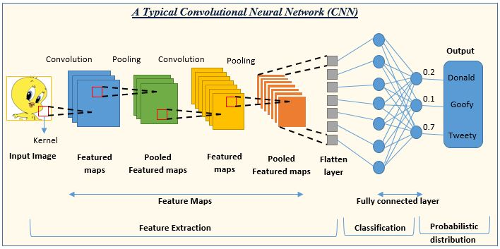

Slide 22
CNN Layers
Convolutional Layer
Pooling Layer
Fully connected Layer

Slide 23
Convolution
Convolution is a pointwise multiplication of two functions to produce a third function.
Primary purpose of convolution in CNN is to extract features from the input image.
Matrix formed by sliding the filter over the image and computing the dot product is called the ‘Convolved Feature’ or ‘Activation Map’ or the ‘Feature Map‘.
Keywords: Filter , Kernel , stride, padding

Slide 24
Convolution Example
3 | 0 | 1 | 2 | 7 | 4
1 | 5 | 8 | 9 | 3 | 1
2 | 7 | 2 | 5 | 1 | 3
0 | 1 | 3 | 1 | 7 | 8
4 | 2 | 1 | 6 | 2 | 8
2 | 4 | 5 | 2 | 3 | 9
1 | 0 | -1
1 | 0 | -1
1 | 0 | -1
Convolution
-5 | -4 | 0 | 8
1 | 0 | -1
1 | 0 | -1
1 | 0 | -1
=
*
3X3 Filter (fXf)
6X6 Matrix (nXn)
3*1+0*0+1*(-1)+1*1+5*0+8*(-1)+2*1+7*0+2*(-1)=-5

Slide 25
Convolution Example
3 | 0 | 1 | 2 | 7 | 4
1 | 5 | 8 | 9 | 3 | 1
2 | 7 | 2 | 5 | 1 | 3
0 | 1 | 3 | 1 | 7 | 8
4 | 2 | 1 | 6 | 2 | 8
2 | 4 | 5 | 2 | 3 | 9
1 | 0 | -1
1 | 0 | -1
1 | 0 | -1
Convolution
-5 | -4 | 0 | 8
1 | 0 | -1
1 | 0 | -1
1 | 0 | -1
=
*
3X3 Filter (fXf)
(n-f+1)X(n-f+1)
6X6 Matrix (nXn)

Slide 26
Filters and Feature Maps
One of the most influential studies came from David Hubel and Torsten Wiesel, who discovered that parts of the visual cortex are responsible for detecting edges.
In 1959, they inserted electrodes into the brain of a cat and projected black-and-white patterns on the screen.
They found that some neurons fired only when there were vertical lines, others when there were horizontal lines, and still others when the lines were at particular angles.

Slide 27
Filters and Feature Maps
Further work determined that the visual cortex was organized in layers.
Each layer is responsible for building on the features detected in the previous layers—from lines,to contours, to shapes, to entire objects.
The first concept that arose was that of a filter (essentially a feature detector)

Slide 28
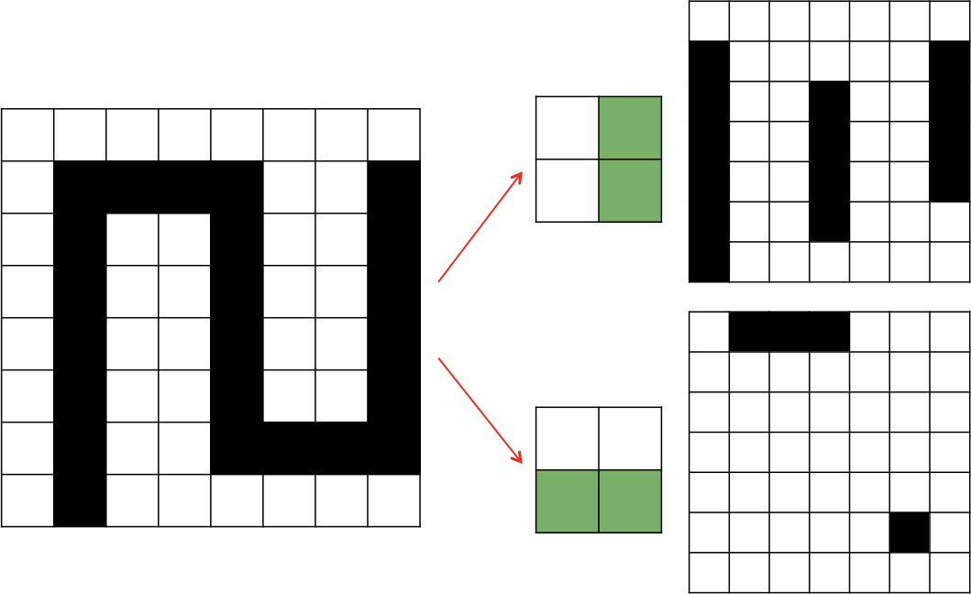
Applying filters detect vertical and horizontal lines
feature map- indicates where we’ve found the feature we’re looking for in the original image
Convolution- take a filter and we multiply it over the entire area of an input image

Slide 29
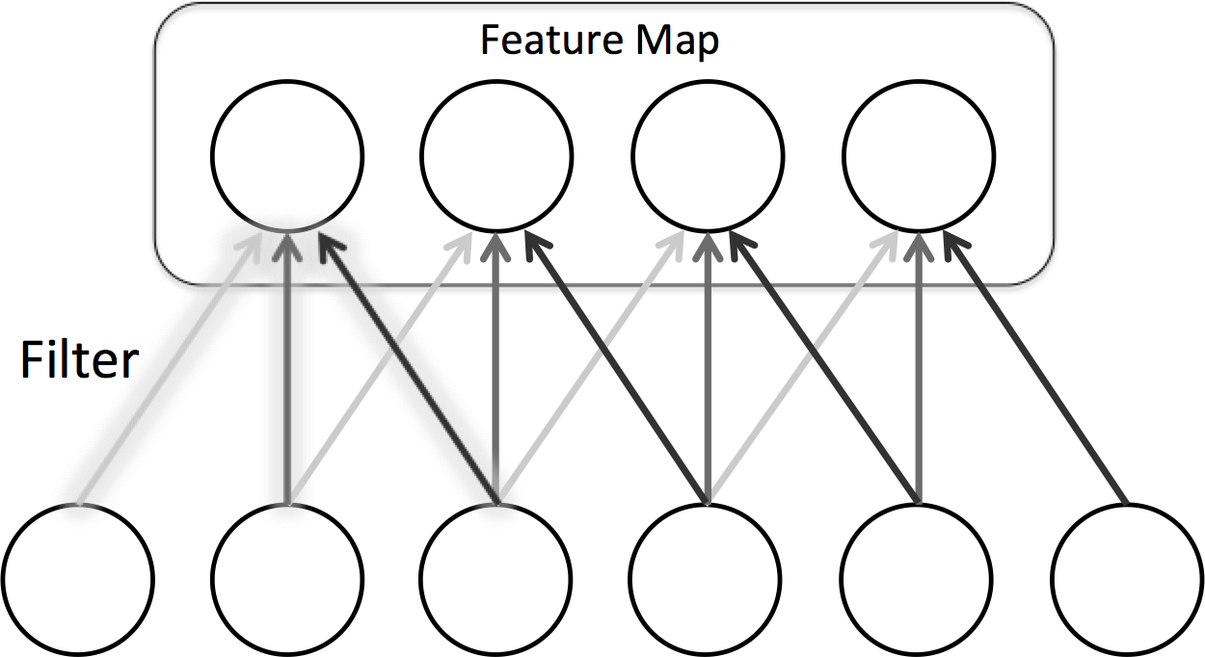
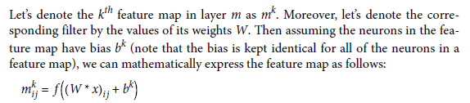
Representing filters and feature maps as neurons in a convolutional layer

Slide 30
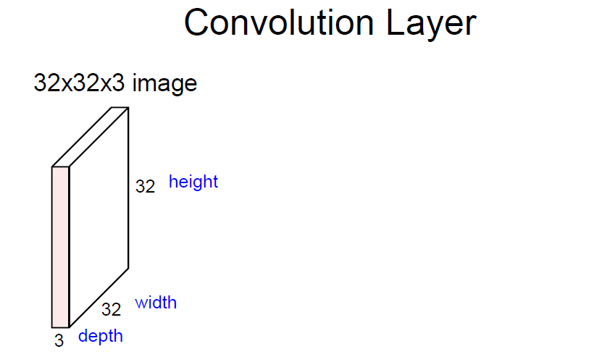

Slide 31
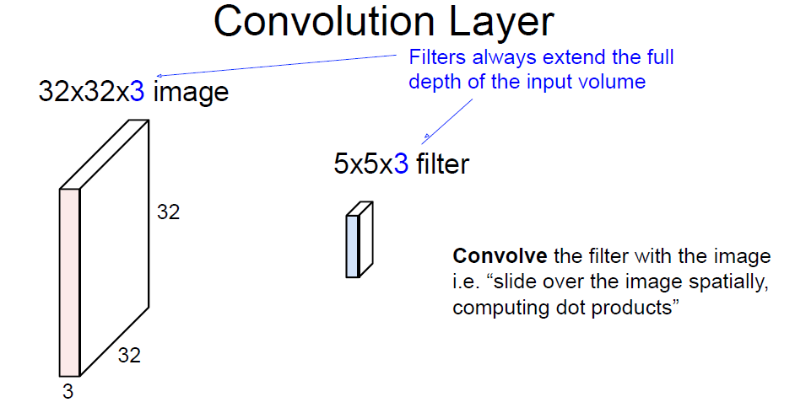

Slide 32
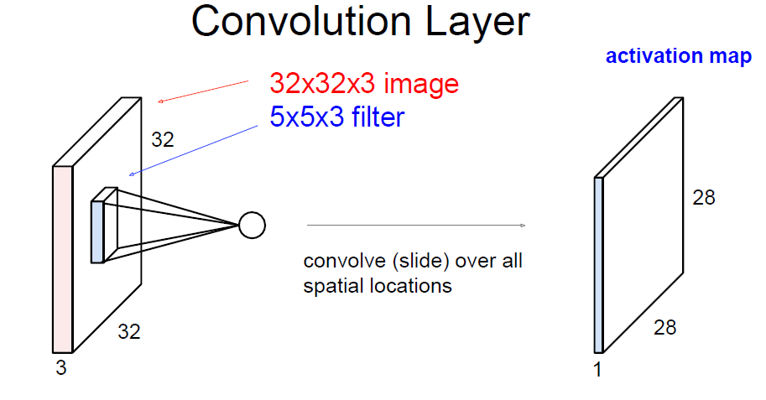

Slide 33
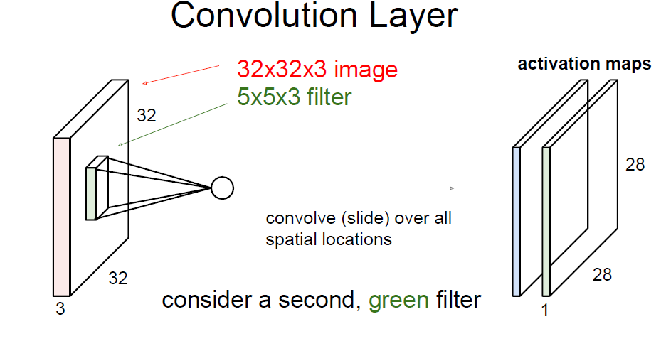

Slide 34
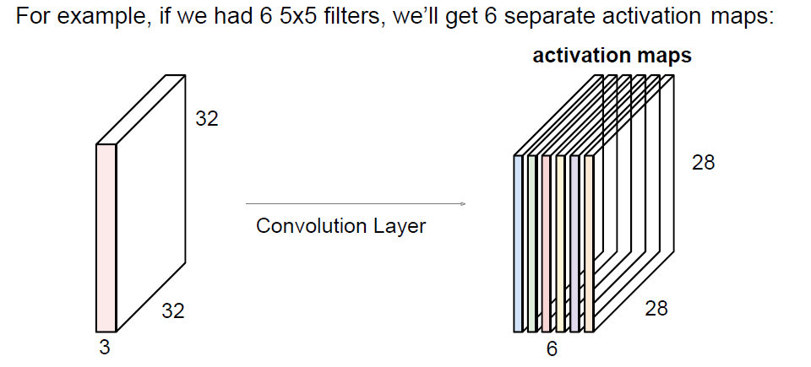

Slide 35
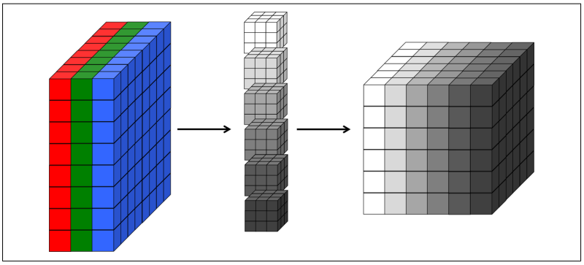

Slide 36
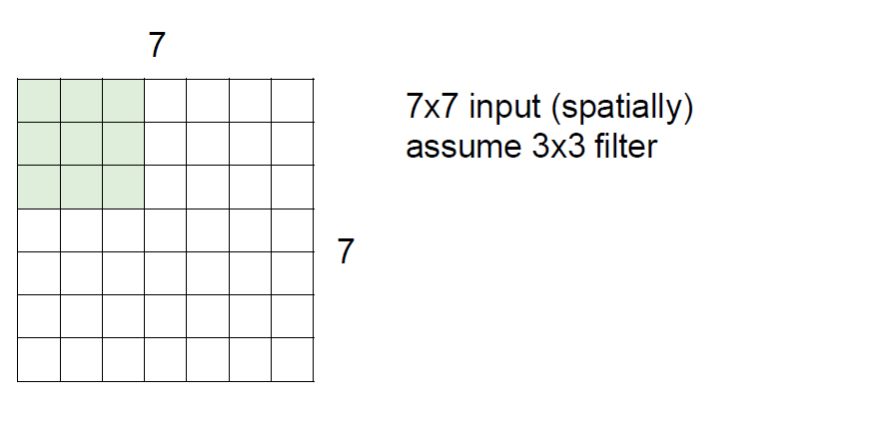
LET WE SPEAK 1 –
What will be the o/p shape?

Slide 37
LET WE SPEAK
(n-f+1)X(n-f+1)
5X5

Slide 38
LET WE SPEAK -2
For example if we had 7 3x3 filters, How many activation map will be created?

Slide 39
LET WE SPEAK
For example if we had 7 3x3 filters, How many activation map will be created?
7 (since no of filters=no of activation map)

Slide 40
Filter Weights
1 | 1 | 1
0 | 0 | 0
-1 | -1 | -1
1 | 0 | -1
2 | 0 | -2
1 | 0 | -1
3 | 0 | -3
10 | 0 | -10
3 | 0 | -3
Horizontal Filter
Sobel Filter
Schorr Filter
w₁ | w₂ | w₃
w₄ | w₅ | w₆
w₇ | w₈ | w₉
Convolutional Neural Networks automatically estimates the weights of the filter

Slide 41
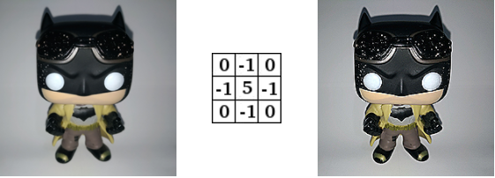
Convolution Sharpen
Different Features
Different Filters detect

Slide 42
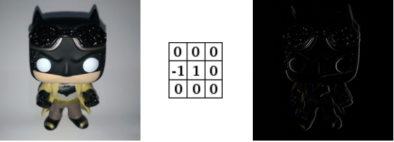
Convolution Edge Enhance
Different Features
Different Filters detect

Slide 43

Convolution Edge Detect
Different Features
Different Filters detect

Slide 44
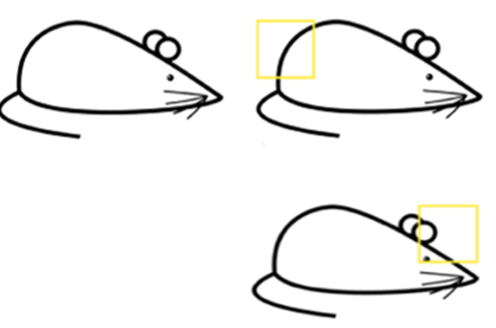
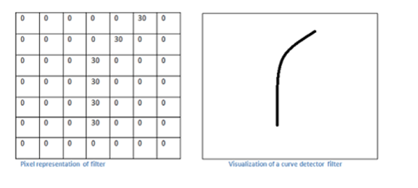
Filter Visualization
More Intuition

Slide 45
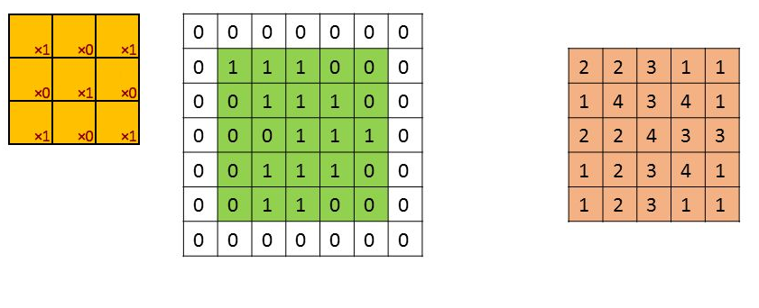
Padding(optional)
Padding is used to preserve the original dimensions of the input
Used when some useful information is in boundary,
Zeros are added to outside of the input
Number of zero layers depend upon the size of the kernel (ex: 3X3 filter=one layer of padding) 3/2=floor(1.5)=1
If used then, i/p size= o/p size
5X5 (with padding)
5X5

Slide 46
LET WE SPEAK -3
For example if we had 5x5 filters, How many layers of zero padding needed?

Slide 47
LET WE SPEAK -3
For example if we had 5x5 filters, How many layers of zero padding needed?
5/2 = Floor(2.5)= 2

Slide 48
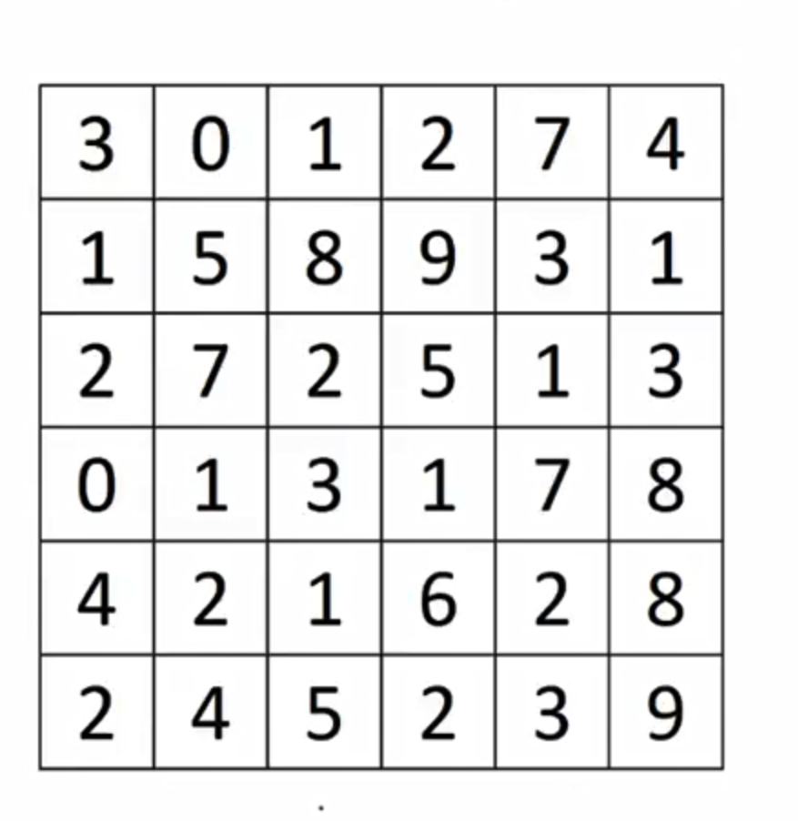
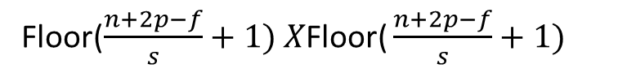
Stride (used for bigger image)
1 | 0 | -1
1 | 0 | -1
1 | 0 | -1
-5 | 8
-3 | -16
2X2
3X3 Filter
Stride=s (3 Here)
Floor($\frac{n+2p−f}{s}+1) X\text{Floor}\text{(}\frac{n+2p−f}{s}+1)$
6X6 Matrix

Slide 49
Stride
1 | 0 | -1
1 | 0 | -1
1 | 0 | -1
-5 | 8
-3 | -16
2X2
3X3 Filter
Stride=s (3 Here)
Floor($\frac{n+2p−f}{s}+1) X\text{Floor}\text{(}\frac{n+2p−f}{s}+1)$
6X6 Matrix

Slide 50
Stride
1 | 0 | -1
1 | 0 | -1
1 | 0 | -1
-5 | 8
-3 | -16
2X2
3X3 Filter
Stride=s (3 Here)
Floor($\frac{n+2p−f}{s}+1) X\text{Floor}\text{(}\frac{n+2p−f}{s}+1)$
6X6 Matrix

Slide 51
Stride
1 | 0 | -1
1 | 0 | -1
1 | 0 | -1
-5 | 8
-3 | -16
2X2
3X3 Filter
Stride=s (3 Here)
Floor($\frac{n+2p−f}{s}+1) X\text{Floor}\text{(}\frac{n+2p−f}{s}+1)$
6X6 Matrix

Slide 52
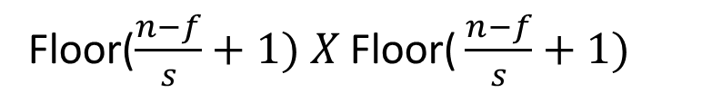
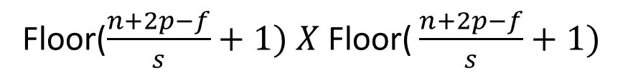
Formula
To find the o/p matrix size:
With stride and padding:
With Stride and Without padding
Floor($\frac{n+2p−f}{s}+1) X \text{Floor}\text{(}\frac{n+2p−f}{s}+1)$
Floor($\frac{n−f}{s}+1) X \text{Floor}\text{(}\frac{n−f}{s}+1)$

Slide 53
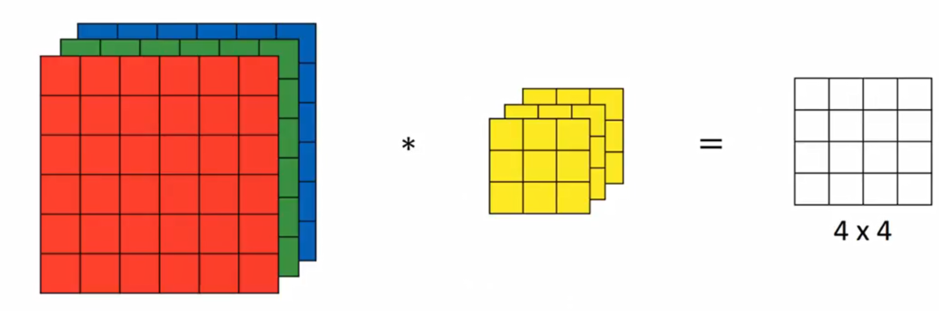
Channels
3X3 Filter
6X6 Matrix
Padding =0 Stride=1

Slide 54
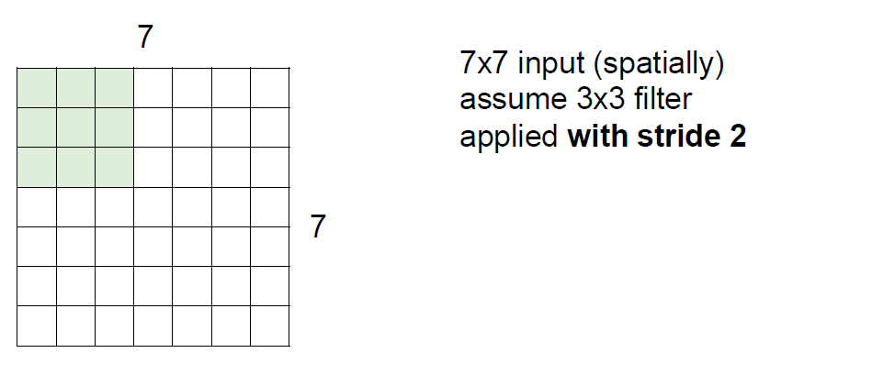
LET WE SPEAK

Slide 55
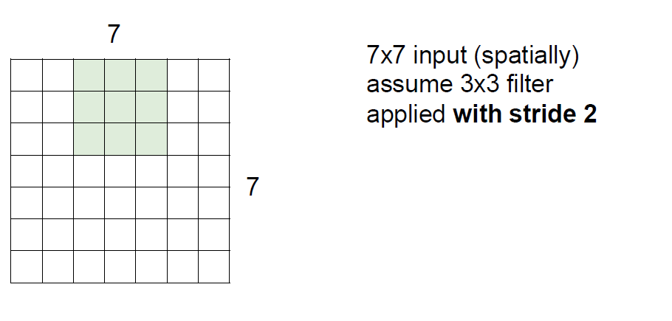

Slide 56
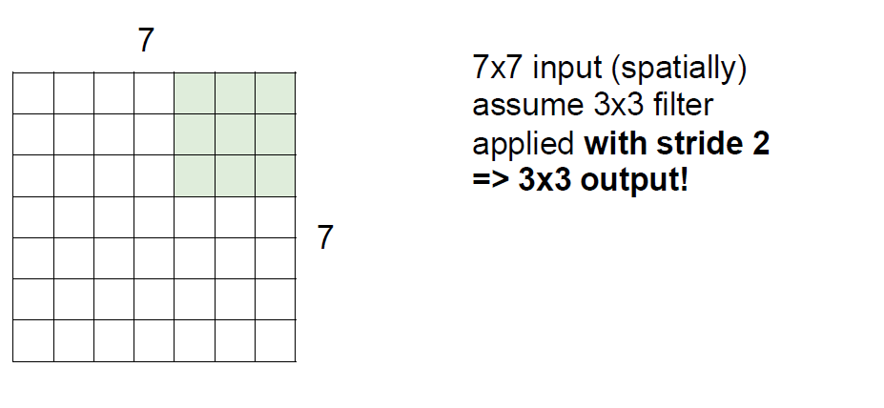

Slide 57
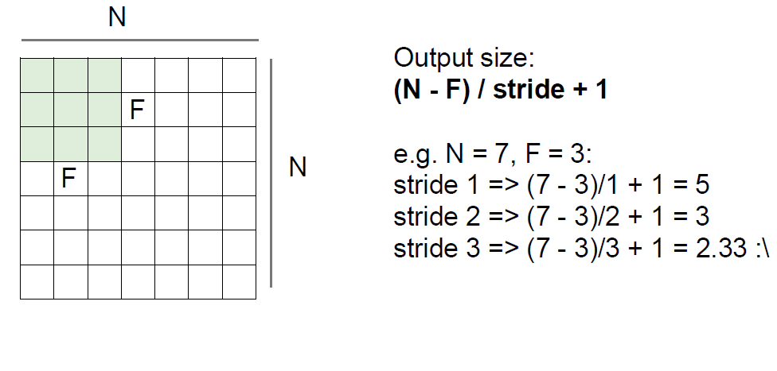

Slide 58
ANN-Even a simple 16x16 image
Input to hidden layer: (16x16)x100 + 100 = 25700

Slide 59
CNN Parameters
Take same image 16x16 size(channel=1→grayscale)
In convolution apply 3X3 filter with stride 1
Number of Parameters= 3X3X1+1(bias) = 10 parameters to be trained
Suppose RGB= 3X3X3+1=28 parameters
If we apply 10 filters: Multiply 10 with the parameters obtained

Slide 60
Pooling
Reduce the spatial size of the representation
Reduce the amount of parameters and computation in the network.
Types of Pooling
Max Pooling (works better)
Average Pooling
Sum Pooling

Slide 61
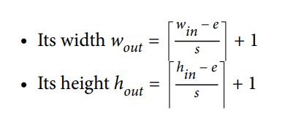
Max Pooling
1 | 4 | 6 | 3
1 | 8 | 9 | 7
2 | 9 | 1 | 2
3 | 4 | 4 | 3
8 | 9
9 | 4
f=2 , s=2
4X4 converted to 2X2
Function of Pooling is to progressively reduce the spatial size of the representation to reduce the amount of parameters and computation in the network.

Slide 62
Pooling
1 | 4 | 6 | 3
1 | 8 | 9 | 7
2 | 9 | 1 | 2
3 | 4 | 4 | 3
8 | 9
9 | 4
Max Pooling : One example of pooling layer
f=2 ,s=2
4X4 converted to 2X2
Function of Pooling is to progressively reduce the spatial size of the representation to reduce the amount of parameters and computation in the network.

Slide 63
Pooling
1 | 4 | 6 | 3
1 | 8 | 9 | 7
2 | 9 | 1 | 2
3 | 4 | 4 | 3
8 | 9
9 | 4
Max Pooling : One example of pooling layer
f=2
s=2 4X4 converted to 2X2
Function of Pooling is to progressively reduce the spatial size of the representation to reduce the amount of parameters and computation in the network.

Slide 64
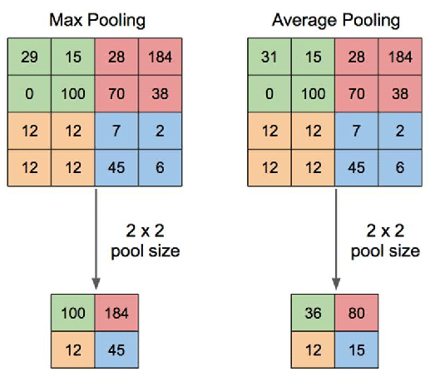

Slide 65
Famous CNN Models
LeNet - 1990
AlexNet - 2012
ZFNet - 2013
GoogLeNet - 2014
VGGNet - 2014
ResNet - 2015
Inception v3 - 2016
MobileNet – 2017
Squeezenet - 2017

Slide 66
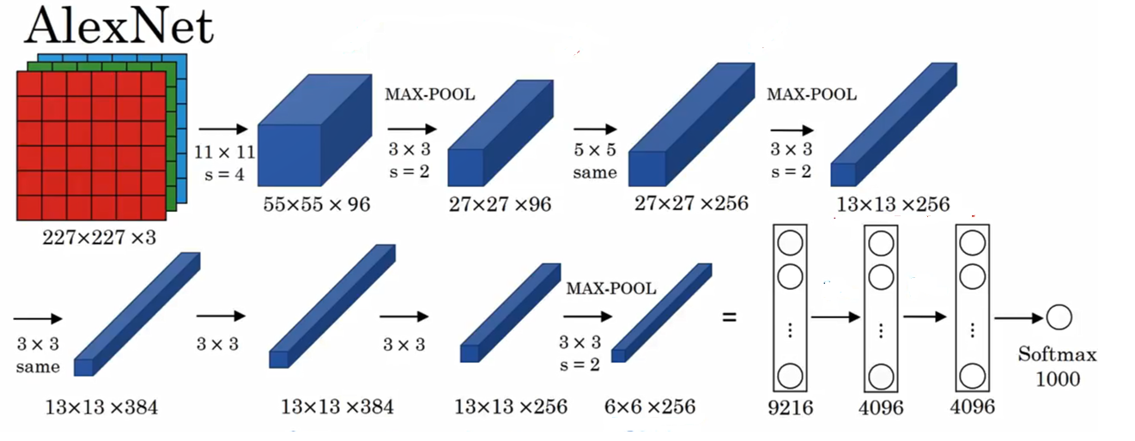

Slide 67
Locally invariant
This means that even if the inputs shift around a little bit, the output of the max pooling layer stays constant.
Local invariance is a very useful property if we care more about whether some feature is present than exactly where it is.
However, enforcing large amounts of local invariance can destroy our network’s ability to carry important information.
As a result, we usually keep the spatial extent of our pooling layers quite small.

Slide 68
fractional max pooling
Some recent work that come out of the University of Warwick from Graham, who proposes a concept called fractional max pooling.
In fractional max pooling, a pseudorandom number generator is used to generate tilings with noninteger lengths for pooling.
Here, fractional max pooling functions as a strong regularizer, helping prevent overfitting in convolutional networks.

Slide 69
https://colab.research.google.com/drive/1oquiOm9pRToQaF5piAd6gwvARb3mv158?usp=sharing

Slide 70
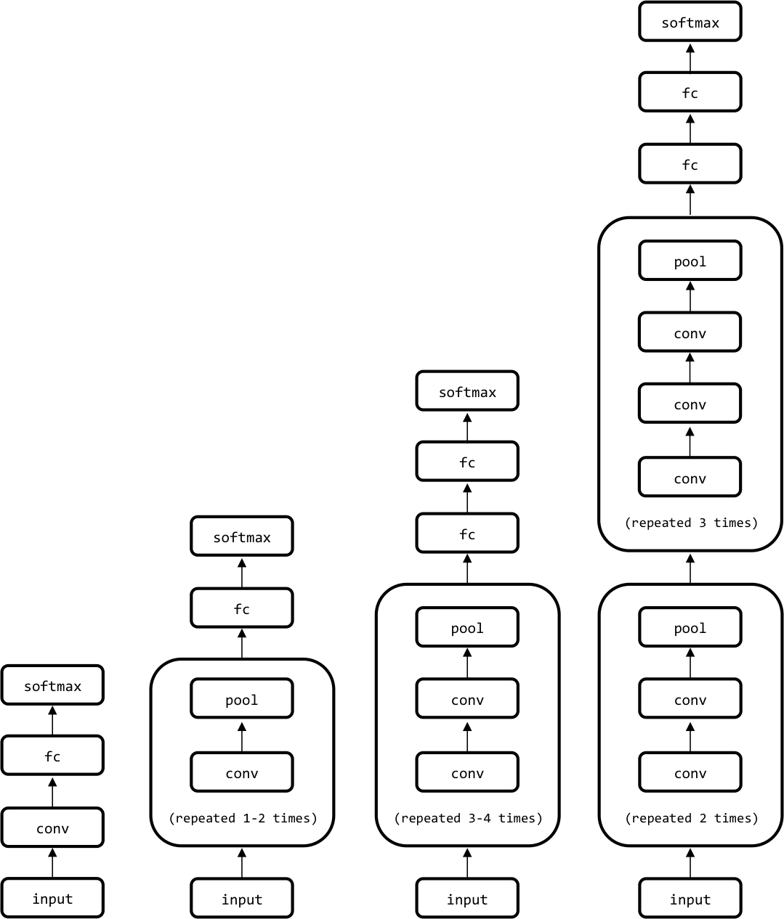
Architectural Description of Convolution Networks
Various convolutional network architectures of various complexities.

Slide 71
deep convolutional networks can take up a significant amount of space
The VGGNet architecture, for example, takes approximately 90 MB of memory on the forward pass per image and more than 180 MB of memory on the backward pass to update the parameters.
Many deep networks make a compromise by using strides and spatial extents in the first convolutional layer that reduce the amount of information that needs to propagated up the network

Slide 72
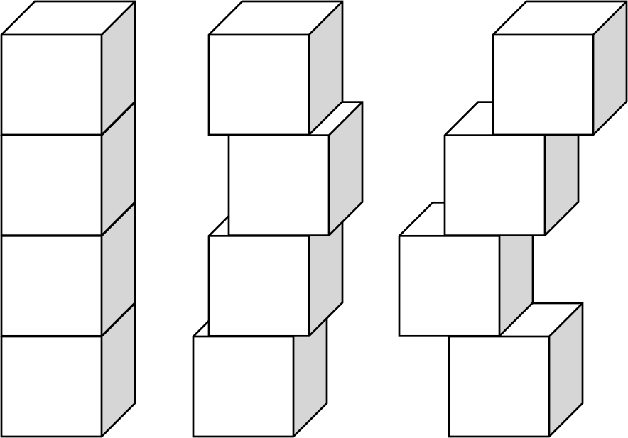
Accelerating Training with Batch Normalization
In 2015, researchers from Google devised an exciting way to even further accelerate the training of feed-forward and convolutional neural networks using a technique
called batch normalization
When blocks in a tower become shifted too drastically so that they no longer align, the structure can become very unstable

Slide 73
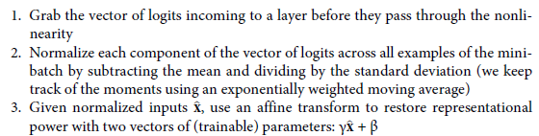
Normalization of image inputs helps out the training process by making it more robust to variations.
Normalization is a data pre-processing tool used to bring the numerical data to a common scale without distorting its shape.
Batch normalization takes this a step further by normalizing inputs to every layer in our neural network.

Slide 74
Visualizing Learning in Convolutional Networks
Simplest thing that we can do to visualize training is plot the cost function and validation errors over time as training progresses.
Without batch normalization, cracking the 90% accuracy threshold requires over 80,000 minibatches.
On the other hand, with batch normalization, crossing the same threshold only requires slightly over 14,000 minibatches.

Slide 75
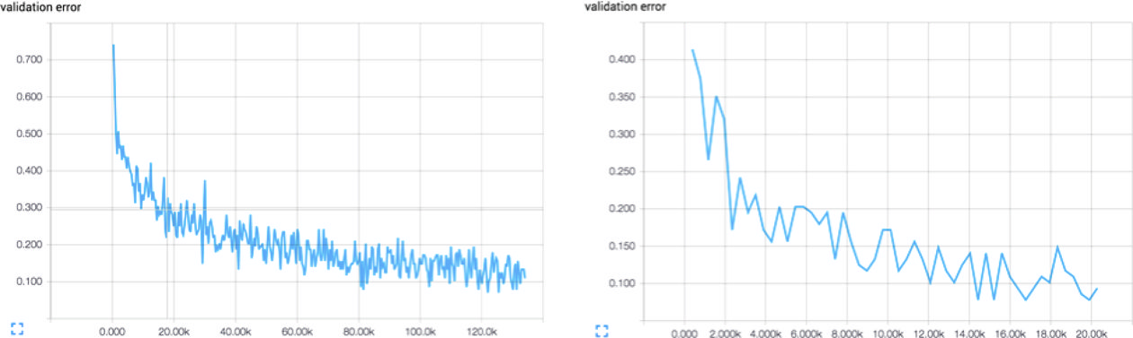
Training a convolutional network without batch normalization (left) versus
with batch normalization (right). Batch normalization vastly accelerates the training
process.

Slide 76
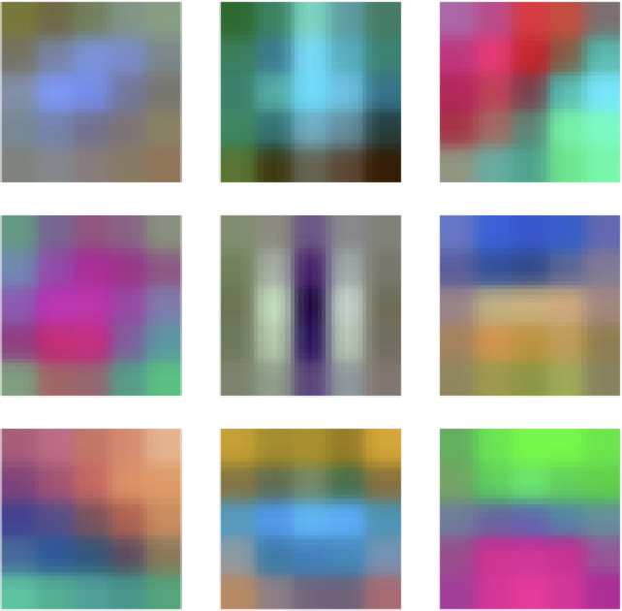
The first convolutional layer learns basic features (edges, simple curves, etc.)
The second convolutional layer will learn more complex features
A subset of the learned filters in the first convolutional layer of our network

Slide 77
Visualizing how our network has learned to cluster various kinds of images pictorially
take a large network that has been trained on the ImageNet challenge and then grab the hidden state of the fully connected layer just before the softmax for each image.
use an algorithm known as t-Distributed Stochastic Neighbor Embedding, or t-SNE, to compress it to a two-dimensional representation that we can visualize
At high level, it seems that images that are similarly colored are closer together.
When zoomed into parts of the visualization, we realize that it’s more than just color.
Convolutional networks have spectacular learning capabilities.

Slide 78
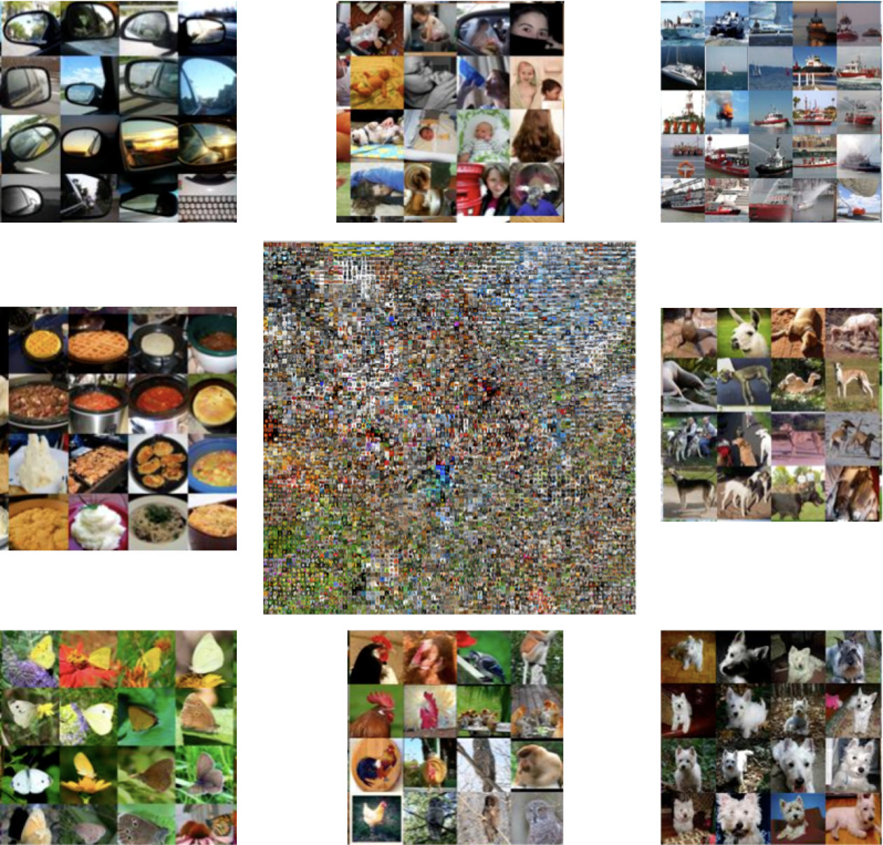
Visualizing how our network has learned to cluster various kinds of
images pictorially
The t-SNE embedding (center) surrounded by zoomed-in subsegments of the embedding (periphery).

Slide 79
Convolutional Filters to Replicate Artistic Styles
Many algorithms developed that leverage convolutional networks in much more creative ways
Neural style
take an arbitrary photograph and rerender it as if it were painted in the style of a famous artist

Slide 80
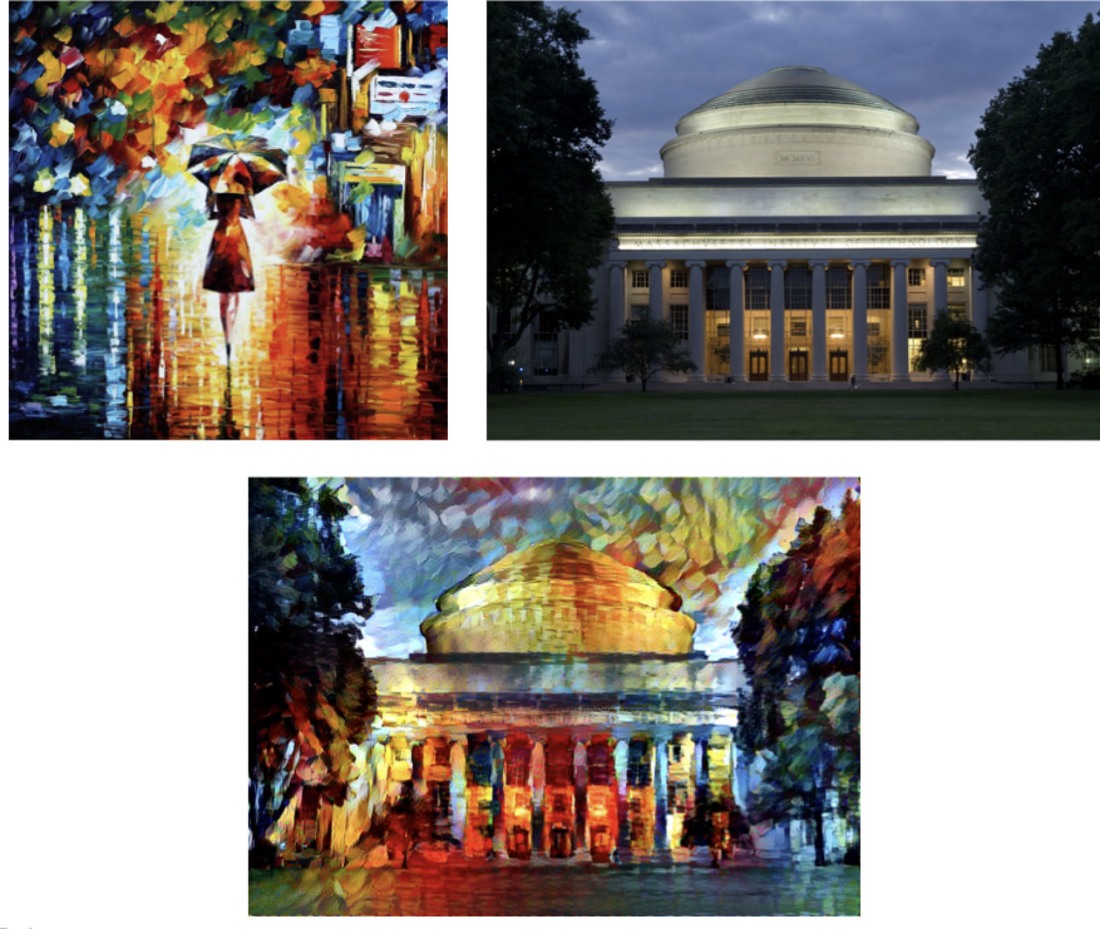
The result of mixing the Rain Princess with a photograph of the MIT Dome.

Slide 81
Three images- source of content p, source of style a, generated image x.
Goal- to derive an error function that when can be backpropagate, when minimized, will perfectly combine the content of the desired photograph and the style of the desired artwork.

Slide 82

Taking content first,
If a layer in the network has k_{l} filters, then it produces a total of k_{l} feature maps.
size of each feature map m_{l}, the height times the width of the feature map
the activations in all the feature maps of this layer can be stored in a matrix F^{(l)} of size k_{l} × m_{l}
the activations of the photograph in a matrix P^{(l)} and all the activations of the generated image in the matrix X^{(l)}.
use the relu4_2 of the original VGGNet

Slide 83



Slide 84

A(l) ➔ Gram matrices for both the artwork
G(l) ➔ Generated image
Error function :

Slide 85
THANK YOU

